Slide 1

Object-Oriented Programming course project
Team:27
1.Bhushan 561 01fe21bec312
2.Prajwal 564 01fe20bec196

Slide 2
Introduction :
Object-Oriented Programming (OOP) is a programming paradigm that uses "objects" to design applications and computer programs. Objects are instances of classes, which can contain both data (attributes or properties) and methods (functions or procedures). OOP focuses on organizing code in a way that is both modular and reusable, making it easier to manage and maintain.
Benefits of OOP:
Modularity: The source code for an object can be written and maintained independently of the source code for other objects.
Reusability: Once a class is written, it can be used to create multiple objects. The class can be reused across different programs.
Scalability: OOP provides a clear modular structure for programs. It is good for defining abstract data types, interfaces, and their relationships.

Slide 3
Problem statement :
To develop and implement Quiz Application with User Authentication.

Slide 4
Objectives :
Provide a platform for users to learn and test their knowledge in a quiz format.
Implement a user authentication and management system.
Design the application to be easily extensible with additional questions and users.
Provide an engaging and user-friendly interface for interaction.

Slide 5
OOP Features:
Encapsulation:
Usage: Classes like Question, Quiz, and User encapsulate their data members (questionText, options, correctAnswer, questions, score, name, password, userDatabase) and methods.
Benefit: This helps in organizing related data and operations together, providing a clear interface for interacting with each component.
Abstraction:
Usage: Classes like Question, Quiz, and User hide their internal implementation details from the user of the class.
Benefit: Users interact with these classes through well-defined public methods (displayQuestion, startQuiz, login, takeQuiz), without needing to understand the complexities of their internal workings.
Constructors:Constructors are special member functions used to initialize objects. The Question class has two constructors, one for general initialization and another for parsing a line from a file.
Classes and Objects

Slide 6

Flowchart
No Quiz
(retry login)
Wrong!
(Display correct ans)
Start
Incorrect
No
Login Process
Load Users from File
Get User's
Answer
Login Process
Start Quiz
Display
Question
Yes
Correct
Correct!
(score++)
Questions
complete
Display Score
End Quiz

Slide 7
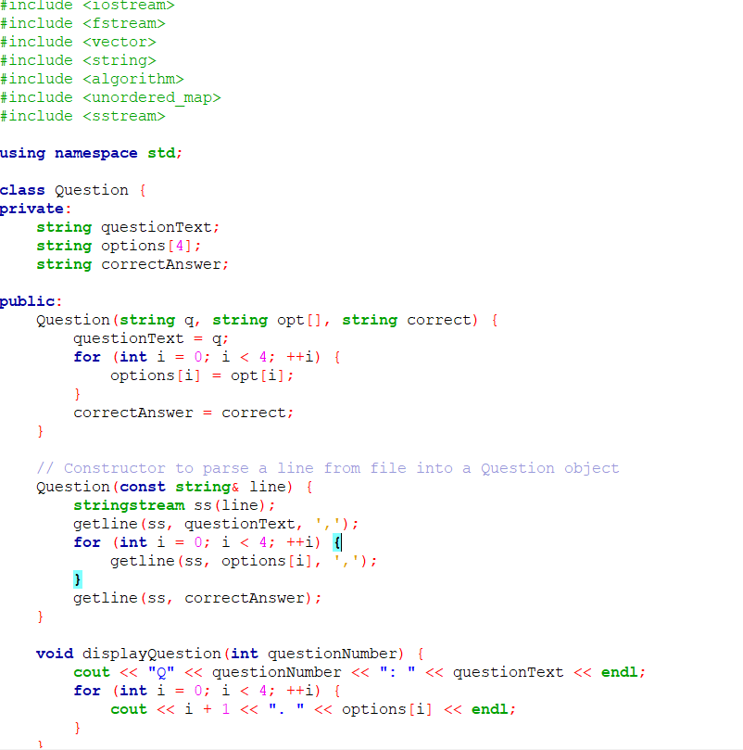
Program:

Slide 8
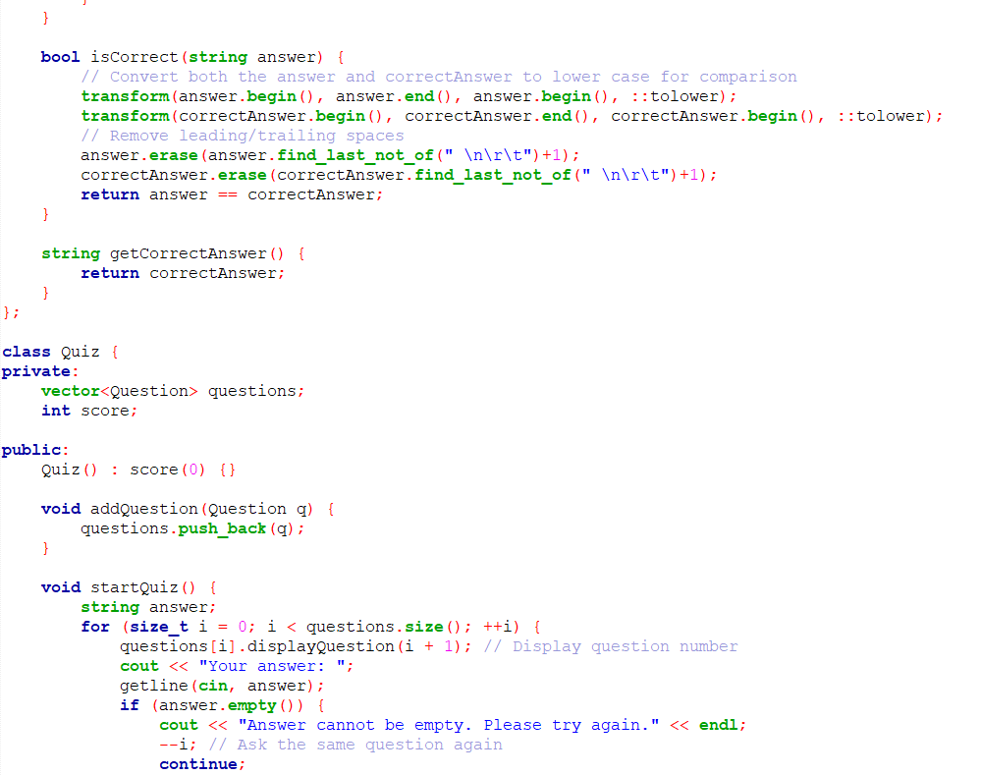
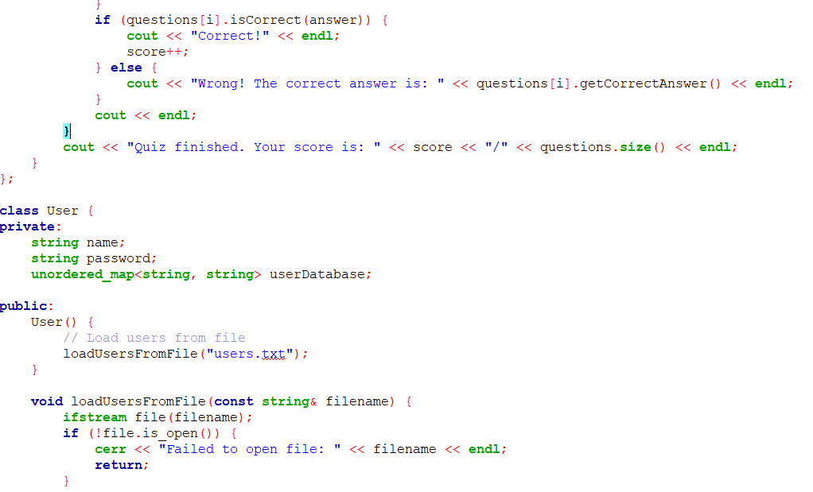

Slide 9
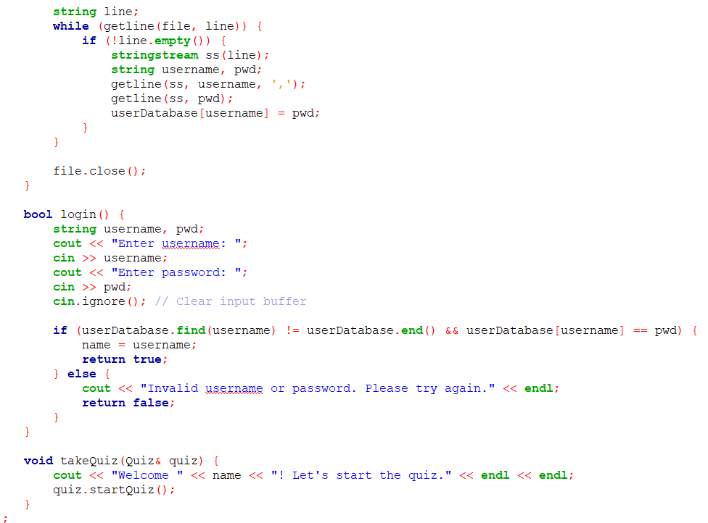
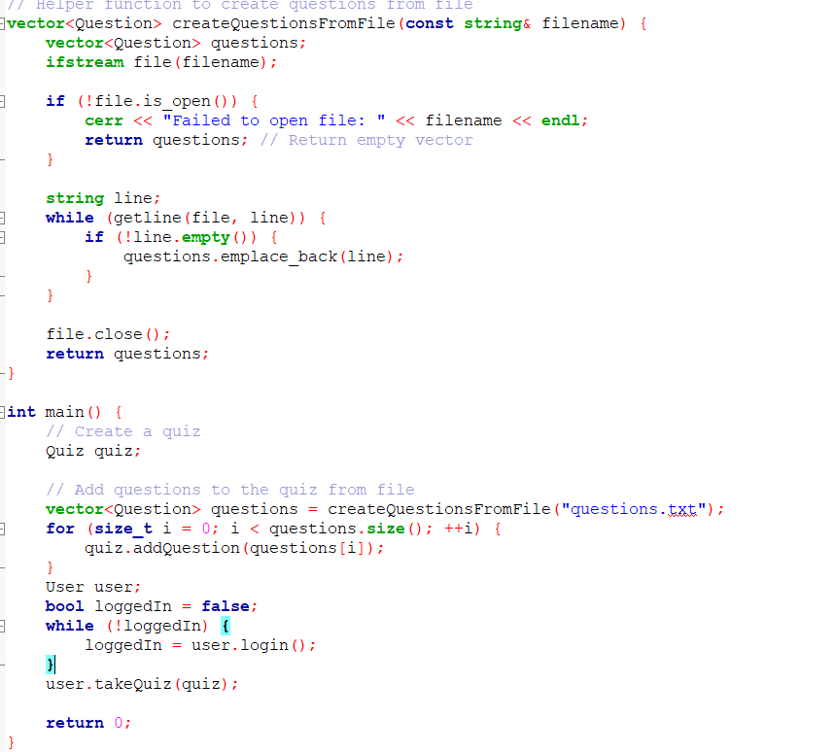

Slide 10
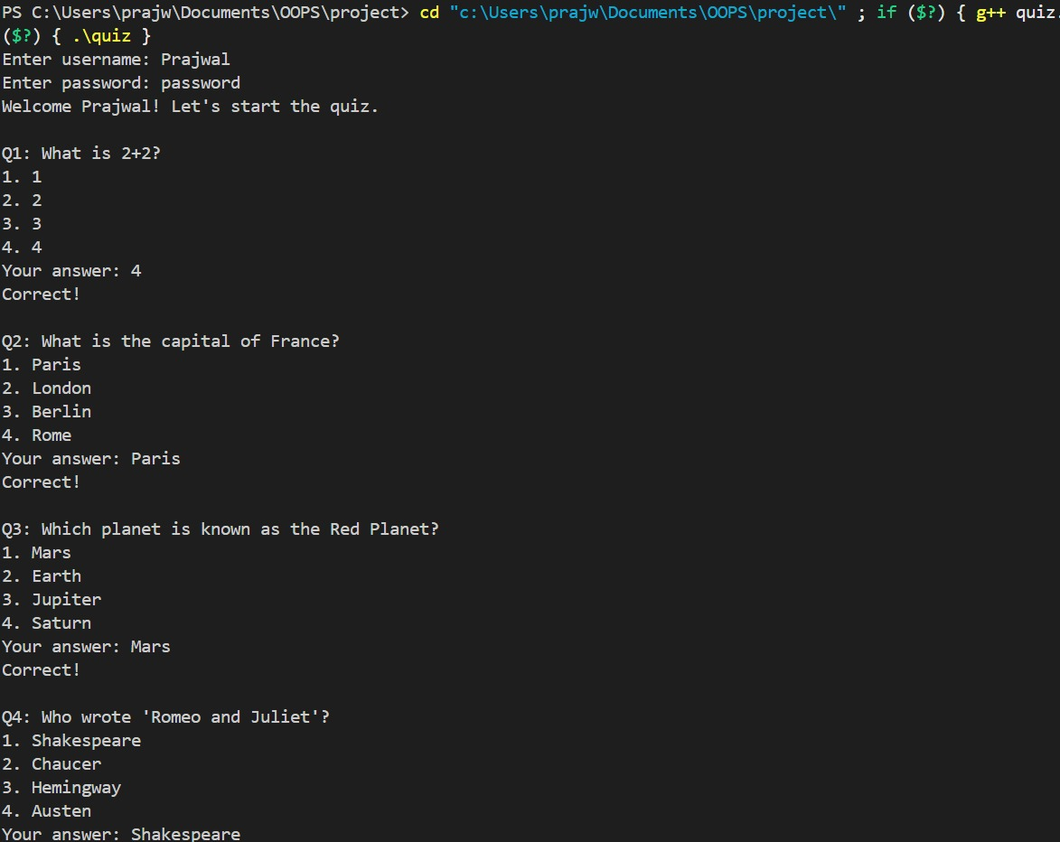
Results: (user 1)

Slide 11
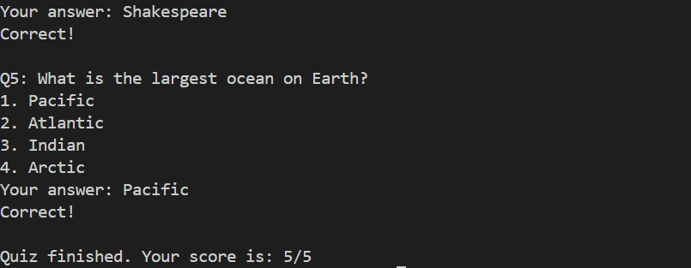
Results: (user 2)

Slide 12
conclusion:
To conclude, we demonstrate a comprehensive application of Object-Oriented Programming (OOP) principles in C++. This project integrates key OOP concepts such as inheritance, encapsulation, and polymorphism, resulting in a modular, reusable, and maintainable design. A simple Quiz app with user authentication process is implemented using OOPs concept.

